Slide 1
8 Smart Nozzle Designs
Patrick Hudak and Dr. Andrew Murray

Slide 2
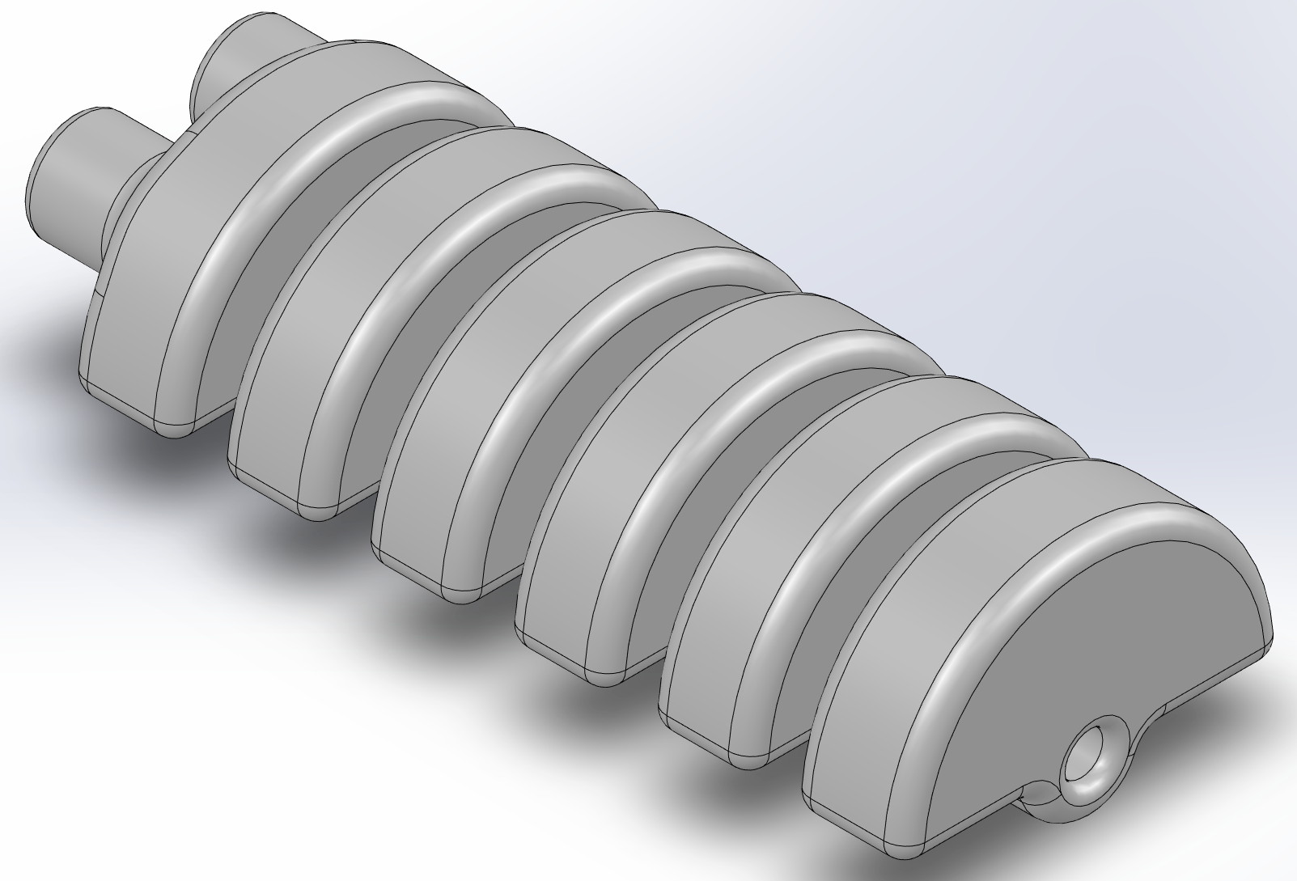
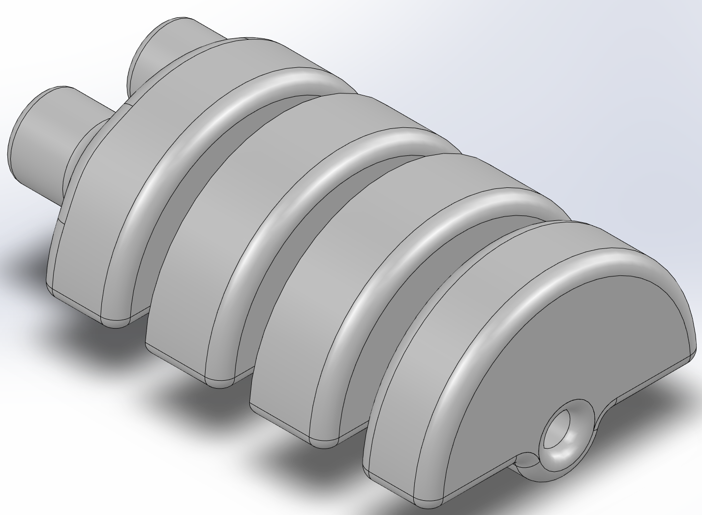
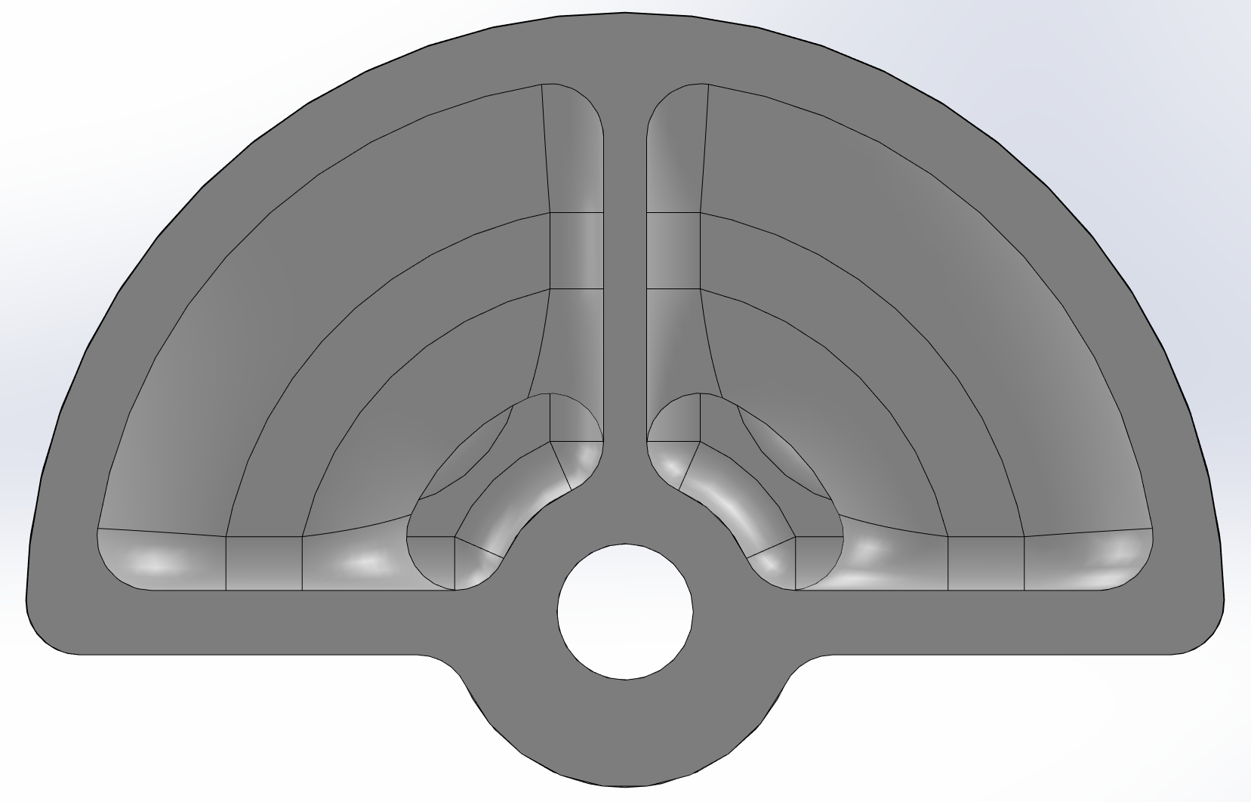
Original Model – 3mm Rounds
Dimensions
Radius - 27.94mm
Length – 137.46mm 93.74mm

Slide 3
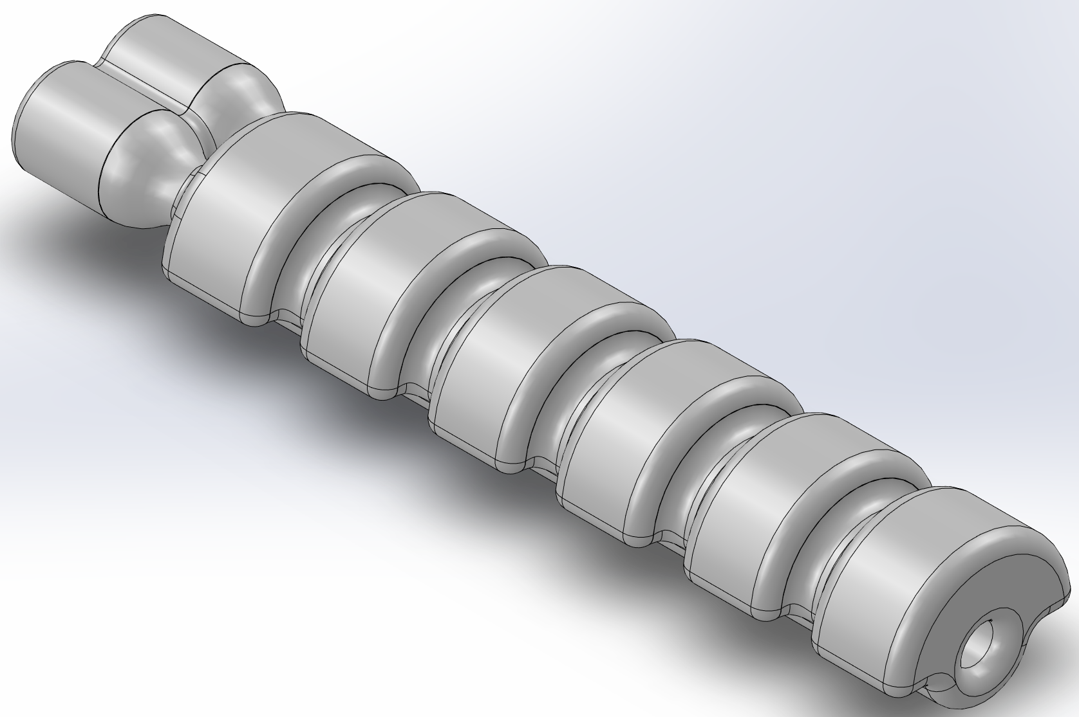
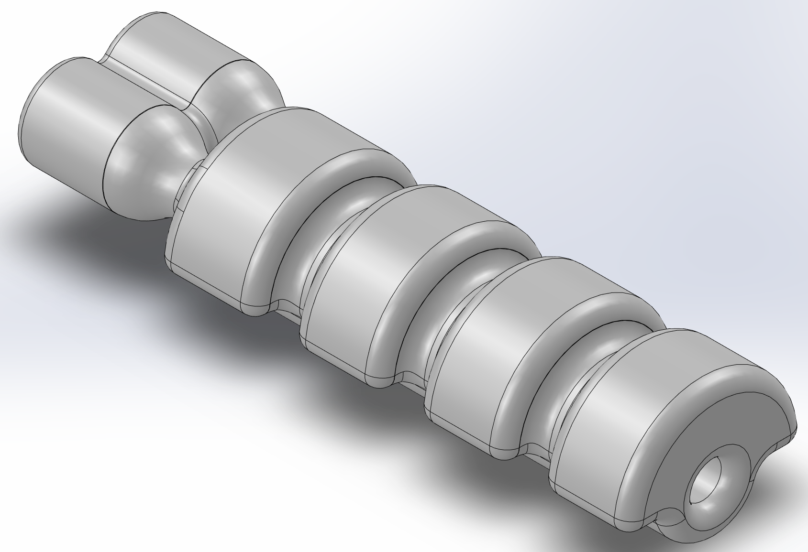
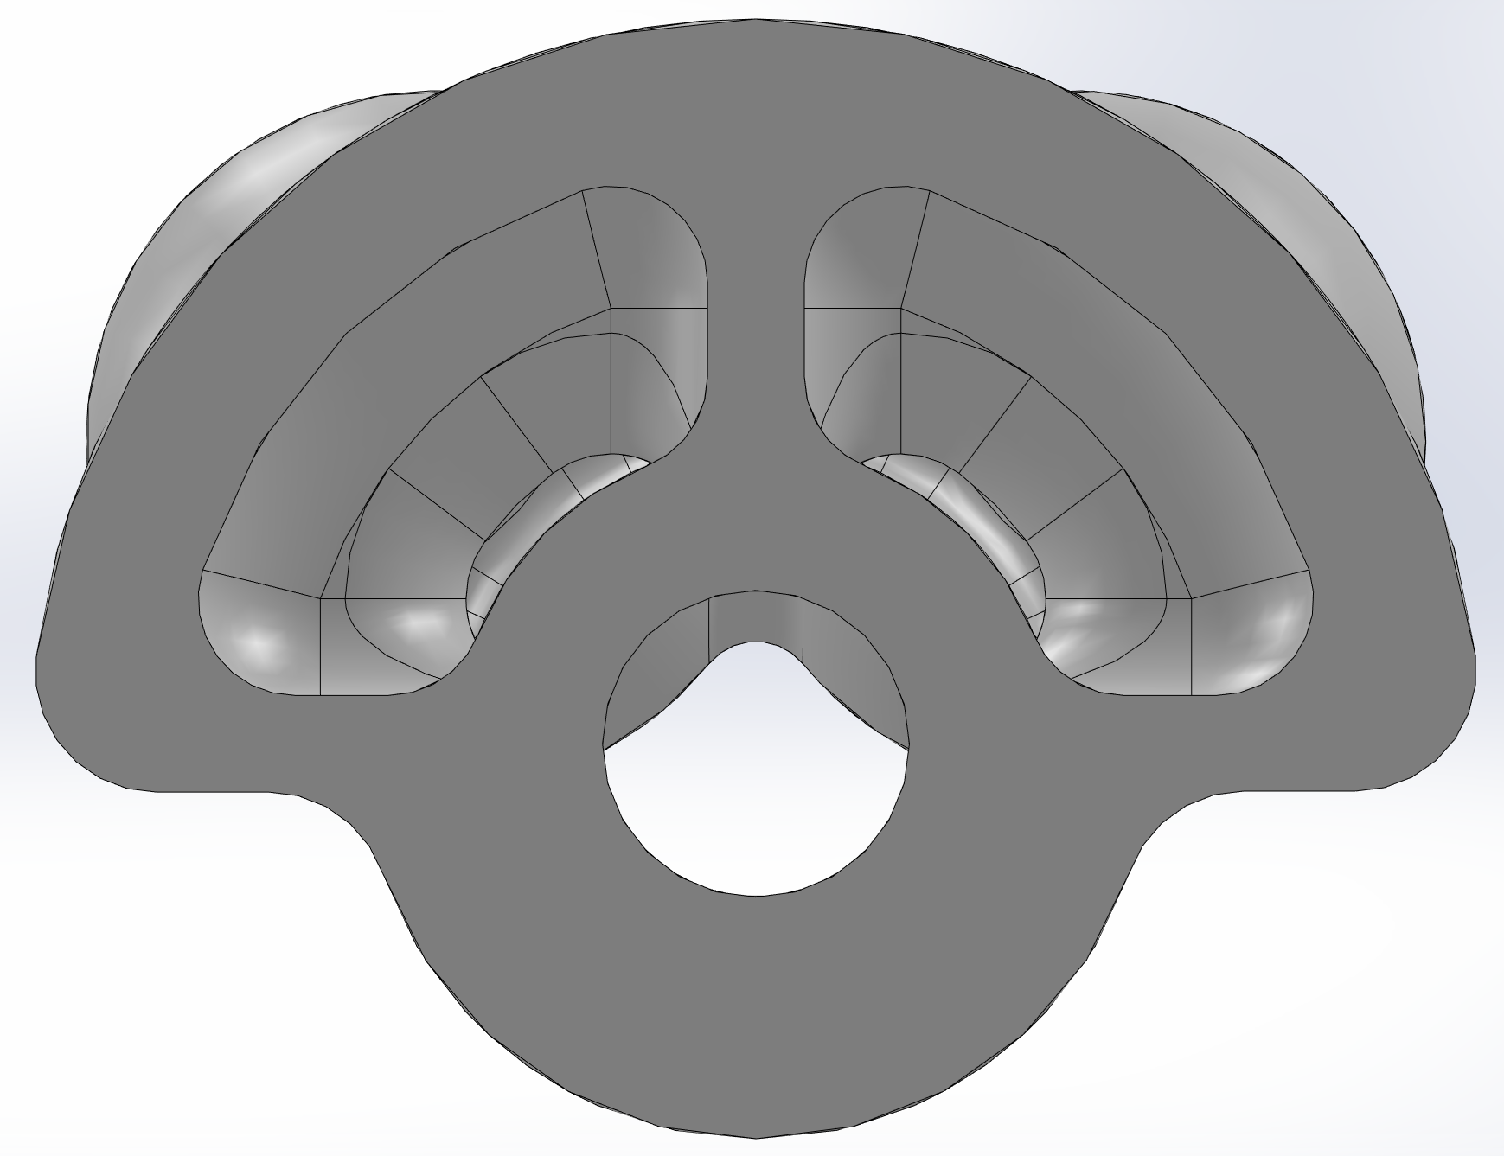
Thin Originial Model
Dimensions
Radius – 15mm
Length – 147.58mm, 104.72mm

Slide 4
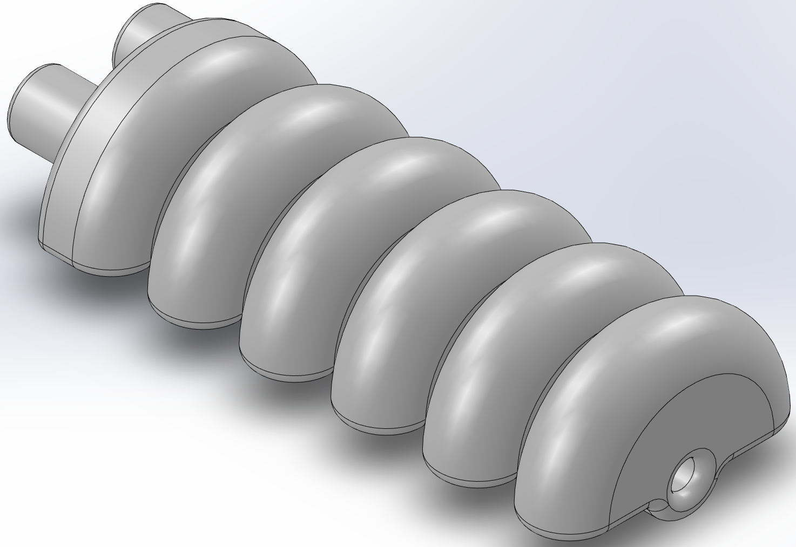
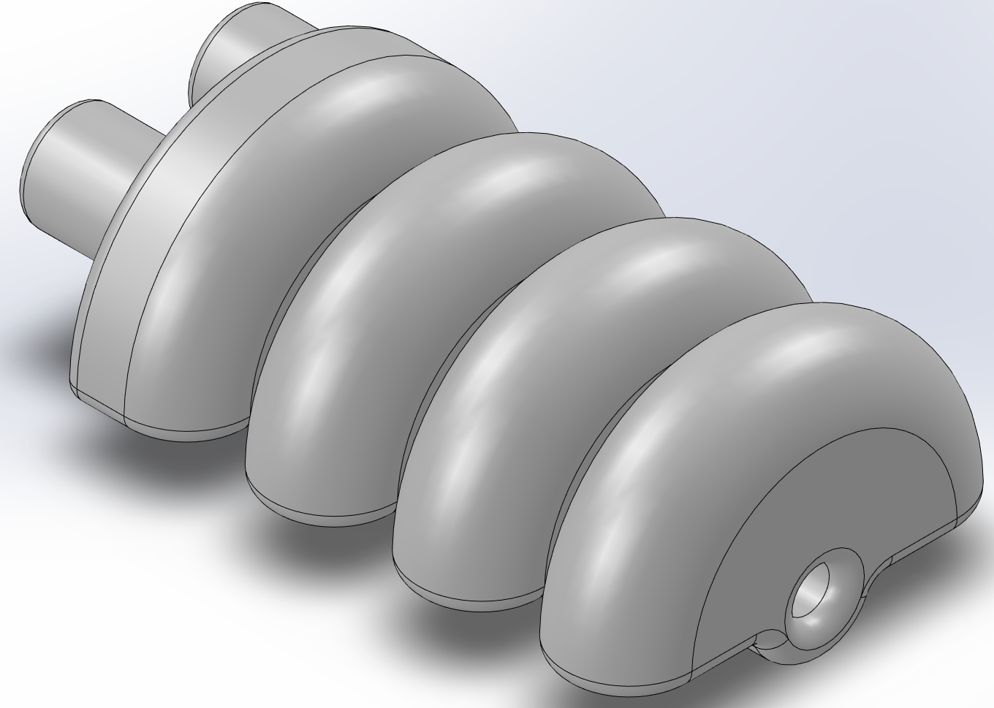
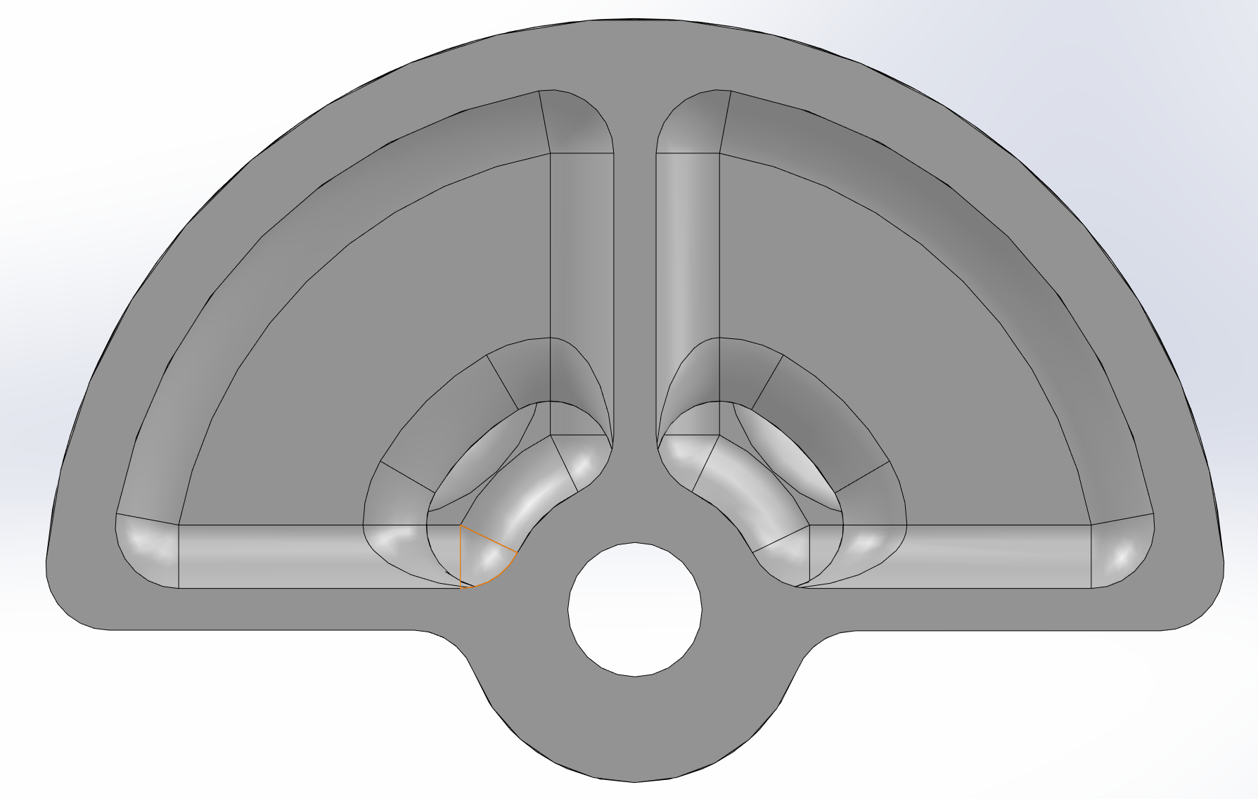
Full Size Torus Model
Dimensions
Radius – 27.91mm
Length – 137.46mm, 93.74mm

Slide 5
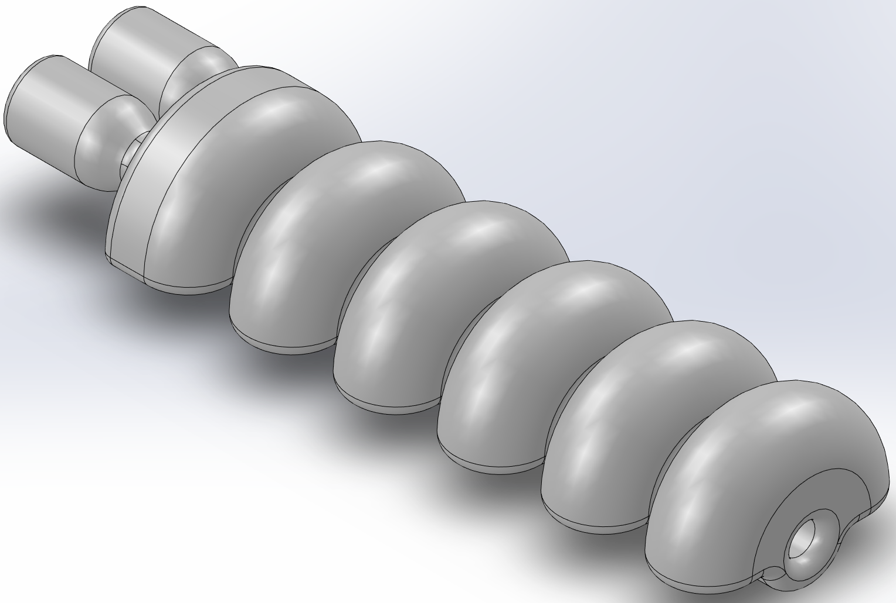
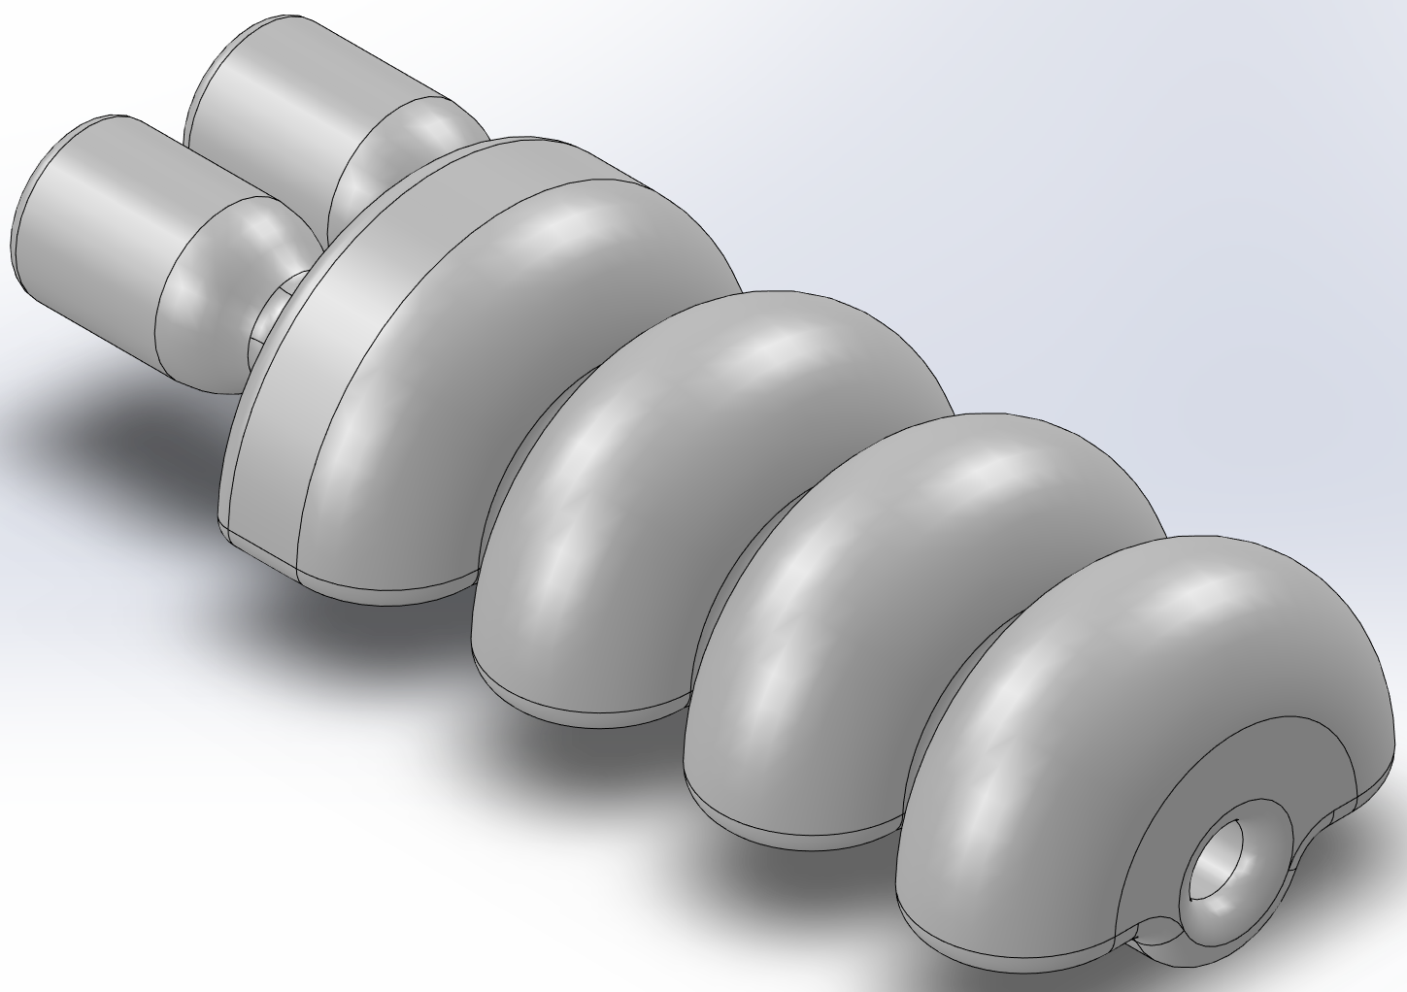
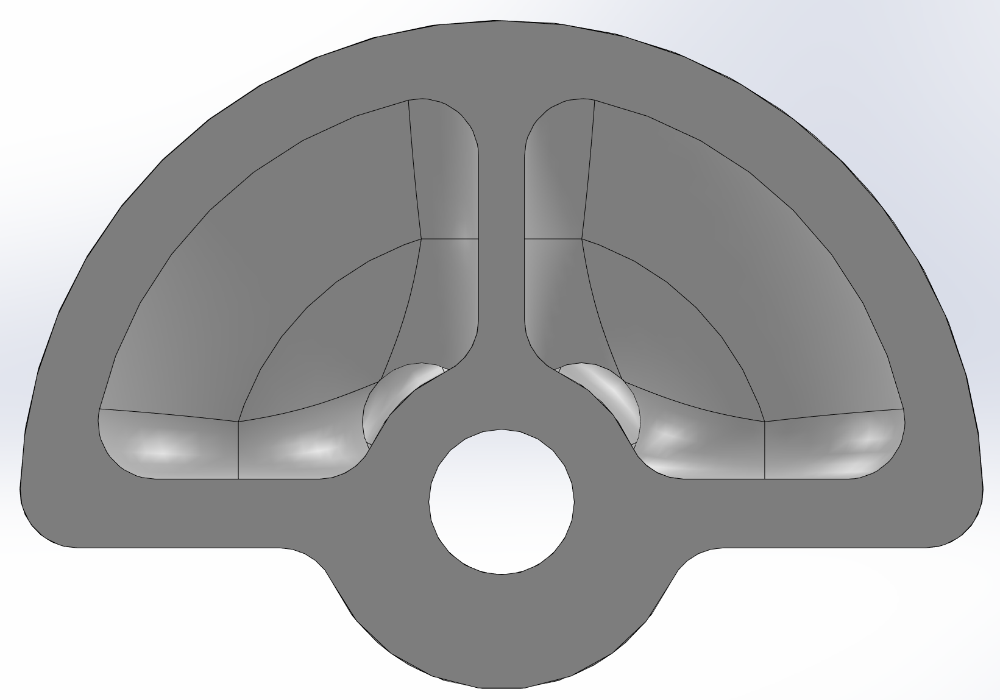
Thin Torus Model
Dimensions
Radius – 21mm
Length – 148.22mm, 106.2mm

Slide 6
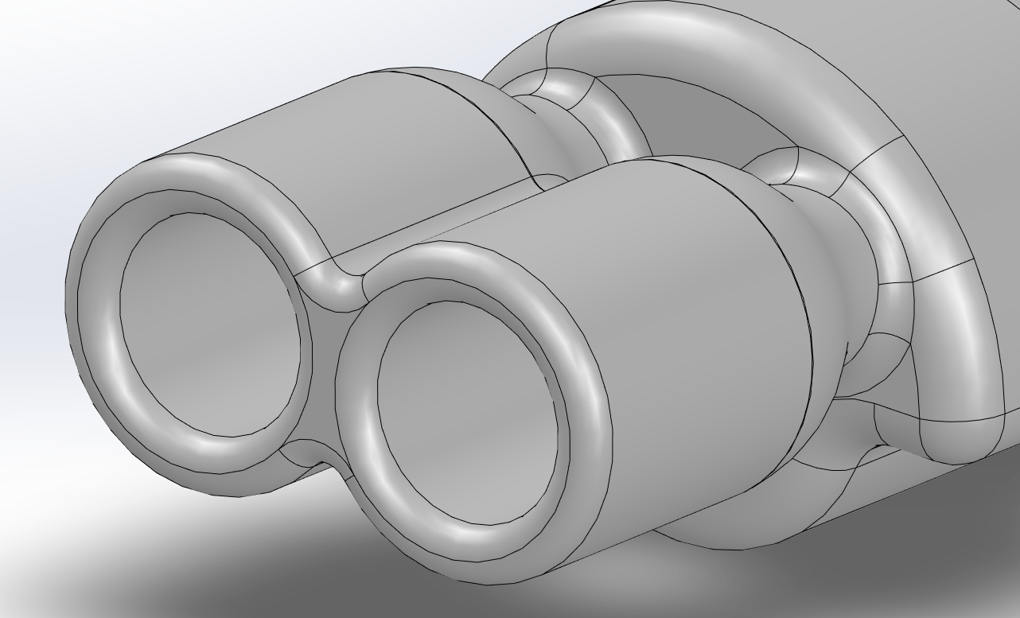
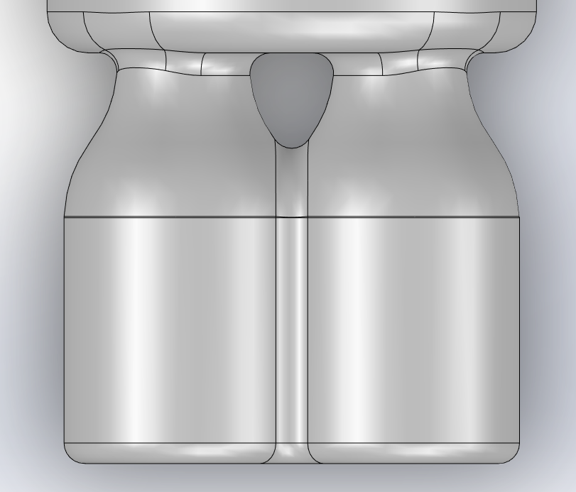
New Air Connector Design

Slide 7
Model Size Comparison
d
A
b
c
f
h
g
e

Slide 8
Model Cross Section Size Comparison
Original Cross Sections
Torus Cross Sections

Slide 9
Look at CFD fluid give this a few hours and download new SW
Did we hear back from ally ask for an update on prints on friday
Get rid of non-pertinent information and models
Clean up google drive make one soft robotic folder for all summer work
Try to run water through the model
Need to make fitting for nozzle
Build Testing Rig
Review assembling and animating a 4 bar mechanism connected by revolute or prismatic joints
Helix with offset chamber and more space between layers
Hexagonal/Octagonal helix

Slide 10
Elastica
Used for studying motion of elastic bodies
Models are constructed using cosserat rods
“mathematical description of 1-dimensional, slender structures that incorporates the effects of bending, twisting, stretching, and shearing”
PyElastica is python-based software that can mathematically simulate motions of elastic bodies.
From what I can tell, this is kinematics based with no mention od dynamics
https://www.cosseratrods.org/#about

Slide 11
Soft Robotics Toolkit
I believe the modeling software is no longer available for public use.

